Slide 1
Semigroups
Lecture 13
Discrete Mathematical Structures

Slide 2
At the Last Class …
Part I: Coloring
  Scheduling Problem
  Vertex Coloring of Graph
Part II: Planar Graph
  Planar Graph and Euler Theorem
  Four-color Problem
  Five-color Theorem

Slide 3
Semigroups
Part I: Semigroup and Monoid
  Binary operations and their properties
  Semigroup and monoid
  Isomorphism and homomorphism
Part II: Fundamental Homomorphism Theorem
  Congruence relation
  Quotient semigroup
  Natural homomorphism
  Fundamental homomorphism theorem for semigroup

Slide 4
Binary Operation
Function ƒ:A^{n}→B is called an n-nary operation from A to B.
  Binary operation: ƒ:A×A→B
  An example: a new operation “*” defined on the set of real number, using common arithmatic operations:
  x*y = x+y-ab
  Note: 2*3 = -1； 0.5*0.7 = 0.85
An operation is a function, so the following are not operations:
  Let A=R, define * on A: a*b as a/b
  Let A=Z, define * on A: a*b as a number less than a,b

Slide 5
Closedness of Operations
For any operation ƒ:A^{n}→B, if B⊆A, then it is said that A is closed with respect to ƒ. Or, we say that ƒ is closed on A.
(What does the operation table of a closed operation look like?)
Example:
  Set A={1,2,3,…,10}, gcd is closed, but lcm is not.
  Discuss the closeness of common addition on the following set:
    {n | there exists a positive integer k, such that 16|n^{k}}
    {n | 9 divides 21n}
Assuming A⊂B，if A is closed with respect to *, what about B? And if B is closed with respect to *, what about A?

Slide 6
Algebraic System
Definition:
  A nonempty set S (no limitation about its elements)
  One or more operations (binary operations in most cases)
  S is closed with respect to these operations
Denotation: (S, )
Example:
  (Z, +), here, Z is the set of integers and + is arithmatic addition

Slide 7
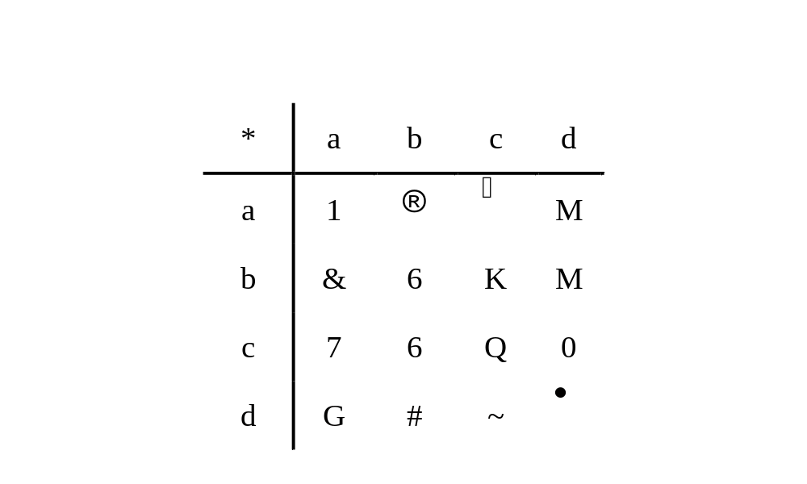
Operation Table
Operation table can be used to define unary or binary operations on a finite set (usually only with several elements)

Slide 8
Properties of Binary Operations
Associativity
  Operation “⃘” defined on the set A is associative if and only if:
  For any x, y, z ∈A, (xy)  z = x (y  z)
Commutativity
  Operation “” defined on the set A is commutative if and only if:
  For any x, y ∈A, x  y = y  x
Idempotence
  Operation “” defined on the set A is idempotent if and only if:
  For any x ∈A, xx =x

Slide 9
Identity of an Algebraic System
For arithmatic multiplication on the set of real number, there is a specific real number 1，satisfying that for any real number x, 1∙x=x∙1=x
An element e is called the identity element of an algebraic system (S, ) if and only if :
For any x∈S, e  x=x  e=x。
Denotation: 1_{S}, or simply 1, but remember that it is not that “1”.
It is not that every algebraic system has its identity element.

Slide 10
An Example about Coding
Given a alphabet A={0,1}, A* is the set of string of length n on A.
Define a binary operation ⊕ on A* as follows:
  For any x,y∈A*, x⊕y is a binary string of length n, in which, the ith bit is 1 if and only if the corresponding bits in x and y are different. (i=0,1,…,n-1)
(A*, ⊕) is an algebraic system
Satisfied properties: association, commutation, identity

Slide 11
A System with Specified Properties
Let (A,*) is a system satisfying idempotent, commutative and associative properties. Define a relation ≤ on A by a≤b iff. a=a*b
Then (A,≤) is a poset, and for all a,b in A, GLB(a,b)=a*b
  Reflexivity: since a*a=a, so, a≤a for all a in A
  Antisymmetry: if a≤b, b≤a, then a=a*b, and b=b*a, but a*b=b*a, so, a=b
  Transitivity: if a≤b, b≤c, then a=a*b, b=b*c, so, a=a*(b*c)=(a*b)*c=a*c, so, a≤c
  GLB:
    a*b is a lower bound of {a,b}: (a*b)=(a*a)*b=(a*b)*a, and similarly, (a*b)=a*(b*b)=(a*b)*b
    a*b is GLB: if c≤a, and c≤b, then c=c*a and c=c*b, so, c=(c*a)*b=c*(a*b)

Slide 12
Axiomatic System
Abstract system: too general
Concrete system: too many
Abstract algebra as a branch of modern mathematics: axiomatic system
  Axioms of the system: usually, one or more of the properties discussed above

Slide 13
Semigroup
Axiom of semigroup
  Association
An example ({1,2},*), * defined as follows:
  For any x,y∈{1,2}, x*y=y
  Proof: it should be proved that for any x,y,z in {1,2}, (x*y)*z = x* (y*z)
  Note: if checking by operation table, we have to check as many as 8 equations.

Slide 14
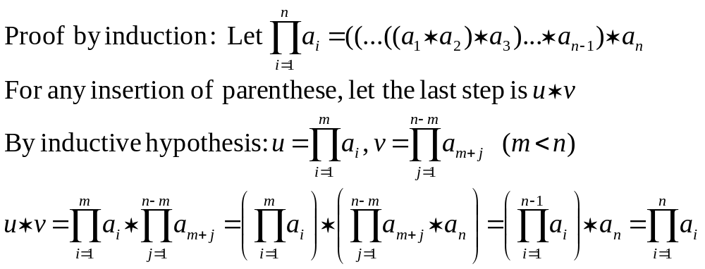
Generalized Associative Law
If a₁, a₂,...a_{n}, n≥3, are arbitrary elements of a semigroup, then all products of the elements a₁, a₂,...a_{n} that can be formed by inserting meaningful parentheses arbitrarily are equal.

Slide 15
Power
If operation “” is associative, then we can define the exponential function as follows:
  x¹ = x
  x^{n+1} = x^{n}  x (n is positive integer)
In addition, if “” has the identity, then:
  x⁰ = e （e is the identity）
  x^{n+1} = x^{n}  x (n is nonnegative integer)
x^{n}  x^{m}= x^{n+m}
(x^{n})^{m}= x^{nm}

Slide 16
Several Examples of Semigroup
Example 1: (A,*) is a semigroupm. For any a,b, if a≠b, then a*b ≠b*a, show:
  (1) a*a = a
  Note: (a*a)*a = a*(a*a)
  (2) a*b*a = a
  (3) a*b*c = a*c
Example 2: (A,*) is a semigroup. There exists an element a in A, such that, for any x in A, there exist u,v, such that a*u=v*a=x. Prove that A has an identity.
  Sketch of proof: for a itself, there are also u_{a},v_{a}, such that,
  a*u_{a} =a; v_{a}*a=a. Then for any x, x*u_{a}=(v_{x}*a)* u_{a}=v_{x}*a=x, which means that u_{a} is a right identity. Similarly, we can prove that v_{a} is also left identity.

Slide 17
Monoid
Axioms of the system
  Association
  Identity
Examples
  P(S), where S is a set, together with the operation union or intersection are both commutative monoids
  The set of all functions f :S→S, denoted as S^{S}, together with the operation of composition is a monoid

Slide 18
Subsystems
Subsemigroup
  Let (S,*) be a semigroup and let T⊆S. If T is closed under the operation *, then (T,*), which is obviously a semigroup itself, is called a subsemigroup of (S,*)
  (Z,+), (Q,+) are both subsemigroups of (R,+)
Submonoid
  Let (S,*) be a monoid with identity e, and let T⊆S. If T is closed under the operation * and e∈T, then (T,*), which is obviously a monoid itself, is called a submonoid of (S,*)

Slide 19
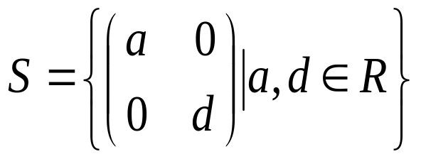
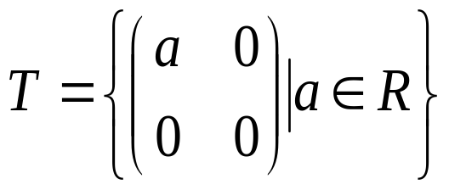
Examples of Subsystem
An Example:
Let “*” be matric multiplication, then both (S,*) and (T,*) are both monoids. T is a subsemigroup of S, but it is not a submonoid(why?).

Slide 20
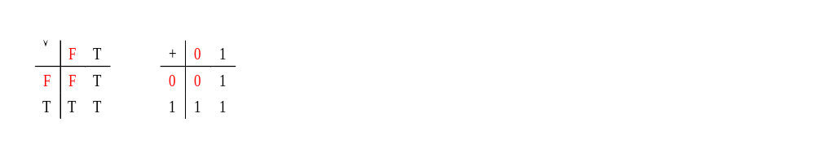
Systems that look alike
“Logical or” and “Boolean sum”
  Note: if the signs and their meaning are ignored, the two tables are same

Slide 21
Isomorphism
Semigroup (S, ) and (T,*) are isomorphic (S≅T) if and only if:
  There exist a one-to-one correspondence f: S→T, such that: (f is called an isomophism)
  For any x,y∈S, f (x  y) = f (x) * f (y)
Isomorphism is an equivalence relation.
  Reflexibility: the identity function is a one-to-one correspondence.
  Symmetry: inverse of a one-to-one correspondence is also a one-to-one correspondence.
  Transitivity: the composition of two one-to-one correspondence is also a one-to-one correspondence.

Slide 22
Show Isomorphism of Two Systems
Basic approach: find a one-to-to correspondence and check it for the requirements for the isomorphism
Examples
  “logical OR” semigroup ({F,T},∨) and Boolean sum semigroup ({0,1},+)
  isomorphism f : {F,T}→{0,1}: f(F)=0, f(T)=1
  Positive real number multiplication semigroup (R⁺,•) and real number addition semigroup (R,+)
  isomorphism f: R⁺→R: f(x)=ln x
  Note: f(x)=lg x is another isomorphism

Slide 23
How to Negate isomorphism
To prove semigroups (S, ) and (T,*) are not isomorphic to each other, you must prove that any functions from (S, ) to (T,*) cannot be an isomorphism between them.
  Example:
  nonzero rational number multiplication semigroup (Q-{0},•) and rational number addition semigroup (Q,+) are not isomorphic to each other
  If there exists an isomorphism f : Q-{0}→Q,
  then f(1)=0 (otherwise, f(1•x)≠f(1)+ f(x))
  However, f(-1)+f(-1)= f((-1)•(-1))=f(1)=0
  So, f(-1)=f(1)，f is not one-to-one, contradiction.

Slide 24
Homomorphism
Semigroup (S, ) and (T,*) are homomorphic, denoted as (S~T) if and only if:
There exists a function f: S→T such that:
  for any x,y∈S, f (x  y) = f (x) * f (y)
If f is also onto, then T is a homomorphic image of G₁.
Note: isomorphism is a special case of homomorphism
Example: integer addition semigroup (Z,+) and mod-3 addition semigroup (Z₃,+₃)
  homomorphism: f : Z→Z₃, f(3k+r)=r
f

Slide 25
Isomorphism and Homomorphism: Generalized
The discussion about isomorphism and homomorphism can be generalized to general algebraic systems
  Algebraic systems (G₁, ) and (G₂,*) are isomorphic if and only if:
    there exists a one-to-one correspondence f: G₁→G₂, such that:
    for any x,y∈G₁, f (x  y) = f (x) * f (y)
  Algebraic systems (G₁, ) and (G₂,*) homomorphic if and only if:
  there exists a function f: G₁→G₂, such that:
  for any x,y∈G₁, f (x  y) = f (x) * f (y)
  And if f is onto, then G₂ is a homomorphic image of G₁.

Slide 26
Homomorphic Image and System Properties
Association
  Assuming that f: G₁→G₂ is a homomorphism, and G₂ is a homomorphic image of G₁, then, if G₁ is associative, so is G₂, i.e. for any x,y,z∈G₂,(x  y)  z=x (y  z)
  Proof: for any x’,y’,z’∈G₂, since f is onto, there must be x,y,z∈G₁, such that f(x)=x’, f(y)=y’, f(z)=z’. So, (x’*y’)*z’ = (f(x)* f(y))* f(z) = f(x  y) * f(z) = f((x  y)  z) = f(x (y  z)) = f(x)* (f(y)* f(z)) = x’*(y’*z’)
Same discussion applies for commutation.

Slide 27
Homomorphic Image and System Properties
Identity
  Assuming that f: G₁→G₂ is a homomorphism, and G₂ is a homomorphic image of G₁, then, if G₁ has an identity e, so does G₂, i.e. there exists e’ in G₂, such that for any x∈G₂, (x*e)=(e*x)=x
  Proof: for any x’∈G₂, since f is onto, there must be x∈G₁, such that f(x)=x’. Let f(e)=e’, then, (x’*f(e)) = (f(x)* f(e))= f(xe) = f(x) = x’. (f(e)*x)=x can be proved similarly.
  Note that f(e) is in G₂, so, it is the identity of G₂.

Slide 28
Holding the System Properties
f
:
function
G
1
G
2
g
:
onto
f (G₁)
h
:
one-to-one correspondence

Slide 29
Homomorphism and Subsystem
Let f be a homomorphism from a semigroup (S, ) to a semigroup (T,*). If S’ is a subsemigroup of (S, ), then
f(S’)={t∈T|t=f(s) for some s∈S’}
the image of S’ under f, is a subsemigroup of (T,*)
Proof
  Closedness of f(S’)
  Associativity hold on f(S’)

Slide 30
Products of Semigroup
If (S,) and (T,*) are semigroups, then (S×T, ⊗) is also a semigroup, called product of semigroups (S,) and (T,*), where ⊗ is defined by (s₁,t₁)⊗(s₂,t₂)=(s₁s₂, t₁*t₂)
Proof
  Obviously, (S×T, ⊗) is a algebraic system
  [Associative] ((s₁,t₁)⊗(s₂,t₂))⊗(s₃,t₃) = ((s₁s₂) s₃, (t₁*t₂)*t₃) = (s₁(s₂s₃), t₁*(t₂*t₃)) = (s₁,t₁)⊗((s₂,t₂)⊗(s₃,t₃))

Slide 31
Products of Monoid
If (S,) and (T,*) are monoids, with identities e_{s} and e_{t}, then (S×T, ⊗) is also a monoid , called product of monoids (S,) and (T,*), where ⊗ is defined by (s₁,t₁)⊗(s₂,t₂)=(s₁s₂, t₁*t₂). And the identity of (S×T, ⊗) is (e_{S},e_{T})
Proof
  Obviously, (S×T, ⊗) is a algebraic system
  [Associative] ((s₁,t₁)⊗(s₂,t₂))⊗(s₃,t₃) = ((s₁s₂) s₃, (t₁*t₂)*t₃) = (s₁(s₂s₃), t₁*(t₂*t₃)) = (s₁,t₁)⊗((s₂,t₂)⊗(s₃,t₃))
  [Identity] For any s∈S, t∈T, (s,t)⊗(e_{s},e_{t}) = (se_{S}, t*e_{T}) = (s,t); same with (e_{s},e_{t})⊗(s,t)

Slide 32
Congruence
An example: defining a relation on the set of integer as: a≡b (mod 3) iff. |a-b|/3 is an integer
  It is an equivalence
  equivalence class: π₁={…-3,0,3,6,9,…}
    π₂={…-2,1,4,7,10,…}
    π₃={…-1,2,5,8,11,…}
Note: if x₁,x₂ are in the same class, and y₁,y₂ in same class, then x₁+y₁ and x₂+y₂ are in the same class.
Generalized: An equivalence relation R on the semigroup (S,*) is called a congruence relation if
aRa’ and bRb’ imply (a*b)R(a’*b’)

Slide 33
Congruence on a Free Semigroup
Let A={0,1}. A* is the set of all finite sequence of elements of A. Then, A* with the operation catenation is a semigroup, called free semigroup generated by A.
Define relation R on A* as following:
αRβ iff. α and β have the same number of 1’s
R is an equivalence
R is a congruence relation
  Suppose α₁ and α₂ have the same number of 1’s, and β₁ and β₂ have the same number of 1’s. Note the number of the number of 1’s in αβ is the sum of that in α and β , so, α₁β₁ and α₂β₂ have the same number of 1’s

Slide 34
All Equivalences are not Congruence
(Z,+) is a semigroup, where “+” is common addition operation.
Given a function f(x)=x²-x-2=(x+1)(x-2), a relation on Z is defined as following:
aRb if and only if f(a)=f(b)
R is an equivalence
R is not a congruence relation
  Note that (-1)R2, and, (-2)R3, but not (-3)R5

Slide 35
Quotient Semigroup
Let R is a congruence relation on the semigroup (S,*). S/R is the quotient set, i.e. the set of all equivalence classed.
Define an operation ⊗ from S/R×S/R to S/R as [a]⊗[b]=[a*b]. Note the operation is well-defined because R is a congruence relation.
  Suppose ([a],[b])=([a’],[b’]), then aRa’, bRb’, by the definition of congruence relation, a*b=a’*b’, so ⊗ is a well-defined function from S/R×S/R to S/R
(S/R,⊗) is a semigroup, called quotient semigroup

Slide 36
Natural Homomorphism
Any semigroup and its corresponding quotient semigroup are onto homomorphic
Let (S/R,⊗) is the corresponding quotient semigroup of semigroup (S,*), define a function f_{R}:S→S/R as following:
f_{R}(a)=[a]
  By the definition of equivalence class, f_{R} is a well-defined onto function from S to S/R.
  For any a,b in S, f_{R}(a*b)=[a*b]=[a]⊗[b]=f_{R}(a)⊗f_{R}(b), which means f_{R} is a homomorphism.

Slide 37


A Congruence Relation Determined by a Homomorphism
Two semigroups
R defined on S
a₁
f(a)=f(a₁)
a
It is easy to prove that R is an equivalence.
R is a congruence relation:
f(ab) = f(a)*f(b)
f(a₁b₁) = f(a₁)*f(b₁)
However: f(a)*f(b) = f(a₁)*f(b₁)
Which means:
f(ab) = f(a₁b₁)
That is: (ab)R(a₁*b₁)
b₁
f(b)=f(b₁)
b
f
(T,*)
(S,)
f is a homomorphism

Slide 38

Fundamental Homomorphism Theorem
Define g: S/T→T as following:
g([a])=f(a) for any [a]∈S/T
1. g is a function: that is for any other
element a’ in [a], g[a’]=f[a]
2. g is one-to-one: all element a having the same value of f(a) are in one equivalence class.
3. g is onto: for any b∈T, there is some a∈S, such that f(a)=b, then g[a]=b.
4. g is an isomorphism:
g([a]⊗[b])=g([ab])=f(ab)=f(a)*f(b) =g([a])*g([b])
Homomorphism
f
(S,)
(T,*)
f_{R}
?
Natural
homomorphism
S
/
T
Quotient
semigroup

Slide 39

An Example of Free Semigroup
Homomorphism
f
f: A*→N: f(α)=the number of 1’s in α
(A*,)
(N,+)
Define relation R on A* as following:
αRβ iff. f(α)=f(β)
Then, by the fundamental homomorphism theorem:
A*/N ≅ N,
and the ismorphism is:
g[α]=the number of 1’s in α. and f = gf_{R}
A={0,1}
Λ∈A*
f_{R}
g
Natural
homomorphism
A*
/
N
Quotient
semigroup

Slide 40
Home Assignments
To be checked
  pp.333-: 5-8, 15-19, 20,22,25, 27-29, 32
  pp.340-: 6,8,10,14,18,21,22,26-27, 31-32, 35-36
  pp.346-: 2, 4, 8,10,14,16,18,23-24, 26, 28, 30
Self tests

Slide 41
Al-Khwarizmi (c.780 – c.850?)
Arab mathematician, born in Khwarizm(now in Uzbekstan). His works on algebra, arithmetic, and astronomical tables greatly advanced mathematical thought, and he was the first to use for mathematical purposes the expression al jabr, from which the English word algebra is derived. The Latin version of his treatise on algebra was responsible for much of the mathematical knowledge of medieval Europe. His work on algorithm, a term derived from his name, introduced the method of calculating by use of Arabic numerals and decimal notation. - from Funk & Wagnalls New Encyclopedia
In fact, “al jabr” originated from the title of his book “Kitab al jabr w’al-muqabala”, which means “reunite” in Arabic.
而中文“代数”一词作为学科名，首先出现于在华的英国人维列利于1853年为介绍西方数学而写的《数学启蒙》(1853)，此时距离Al-Khwarizmi那本书的出版已经超过一千年了。几年后，维列利与中国学者李善兰合作，先后将欧几里德《几何原本》后9卷以及德∙摩根的代数学翻译成中文。

